Slide 1
Performance Analysis of Cricket Bowlers in IPL/WPL 2023
Group 8 :
Eldho John Menachery
Ranjana Jeysree
Yash Goyal
Riya Gupta
Karthik Thilakan E
Sanjana V
Shantanu Kumar Panda

Slide 2

OBJECTIVES
To conduct linear regression analysis on bowlers’ performance in IPL/WPL 2023.
To ascertain the impact of variables like age, economy rate, bowling style, and number of overs bowled on the bowlers’ performance, measured by the total number of wickets taken.
To look into different transformations and interactions between different independent variables and come up with the best possible model.
To gain valuable insights that can be extracted from the identified correlations, offering a deeper understanding of the relationships and their implications.

Slide 3

BOWLER DATASET
Dependent Variable
Independent Variables
Total no. of bowlers
No. of quantitative predictors
No. of categorical predictors
Wickets
Gender
108
8
3
Matches
Innings
Economy Rate,
Age
Instagram Followers
Twitter Followers
Auction Price
Dot Balls
Right/Left Arm
Spin/Pace

Slide 4

TOOLS AND TECHNIQUES USED
R programming language and RStudio IDE
Libraries
tidyverse, UsingR, readr, lmtest, olsrr, dplyr, acret, reshape2, corrplot, coefplot, ggplot2
Multiple linear regression modeling
Correlation matrix, residual analysis, model diagnostic tests and plots
Variable transformation (log)
Interactions between independent variables
Multi-model comparison and automated stepwise variable selection

Slide 5
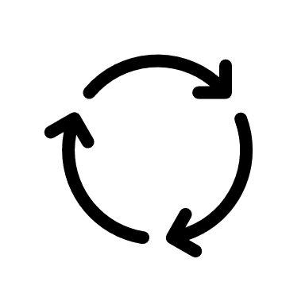
Methodology
Import bowler dataset into RStudio
Check for linearity between independent and dependent variables using simple linear regression plots and model summaries
Validate linear regression assumptions (homoscedasticity and normality of residuals) using diagnostic plots
Create correlation matrix to identify highly correlated variables
Identify and remove outliers from the dataset
Build multiple linear regression models with different variable selections and interactions
Compare models and select the best one having highest R-squared, adjusted R-squared values and lowest RSS
Conduct residual analysis, ANOVA, and influence diagnostics on the final model
Derive insights from the final model

Slide 6

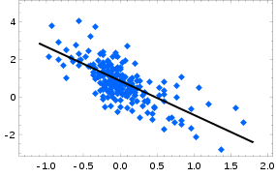

SIMPLE LINEAR REGRESSION
Performed simple linear regression between each independent and dependent variable to check for –
Linearity
Homoscedasticity
Normality of residuals
$$y = β0+β1.x$$

Slide 7
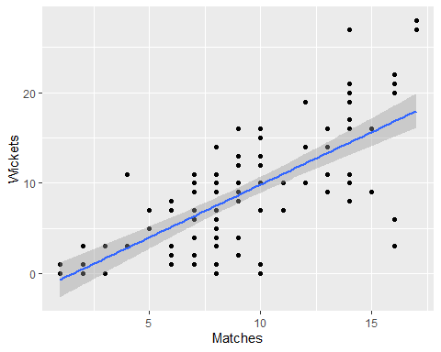
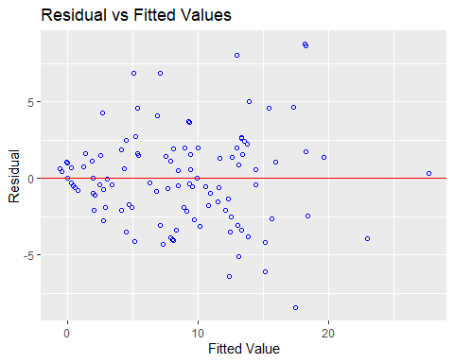
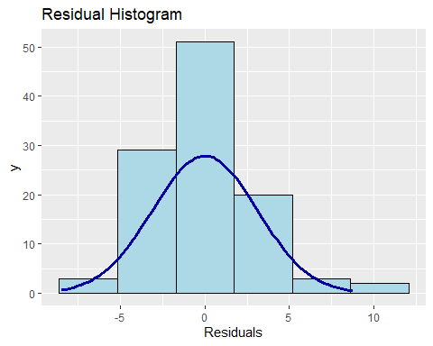
MATCHES AGAINST WICKETS
Matches and Wickets have a strong linear relationship
Obeys homoscedasticity
Shows normality of residuals

Slide 8
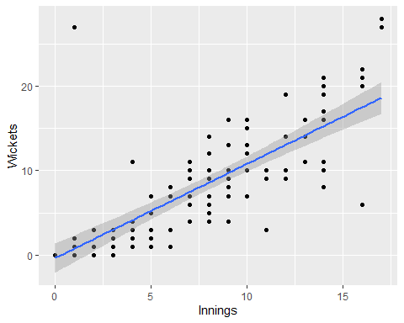
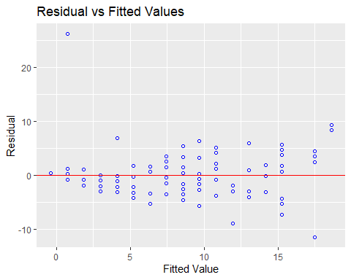
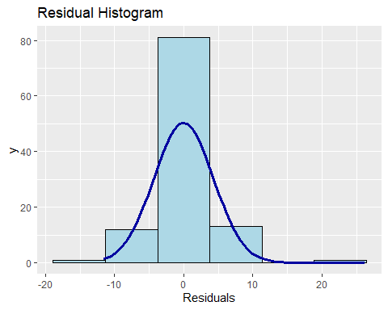
innings AGAINST WICKETS
Innings and Wickets have a strong linear relationship
Obeys homoscedasticity
Residuals follow weak normal distribution

Slide 9
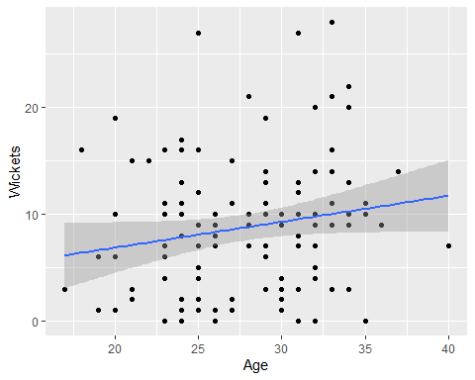
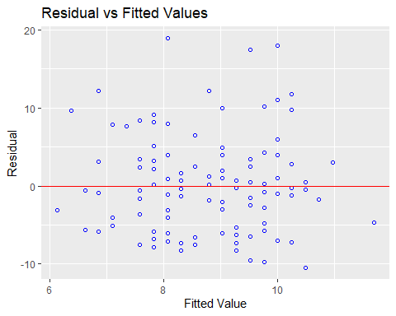
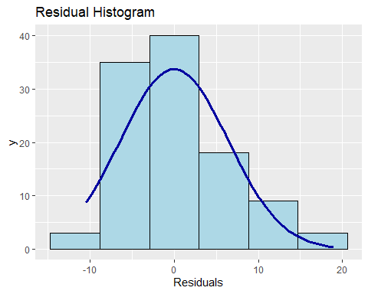
AGE AGAINST WICKETS
Age and Wickets have a weak linear relationship
Do not satisfy homoscedasticity
Residuals show a weak normal distribution
Therefore, they might be removed in the final models

Slide 10
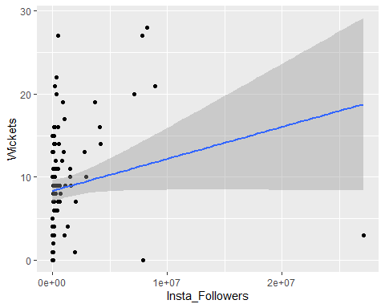
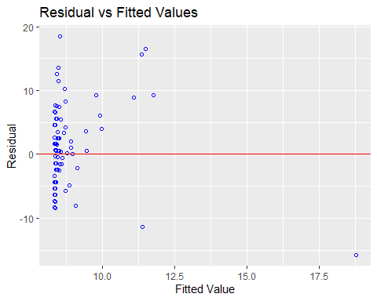
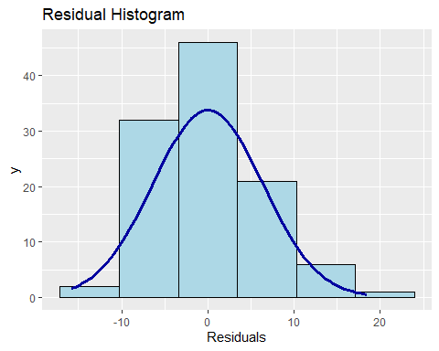
INSTA_FOLLOWERS AGAINST WICKETS
Insta_Followers and Wickets show a weak linear relationship
Obeys homoscedasticity
Shows normality of residuals

Slide 11
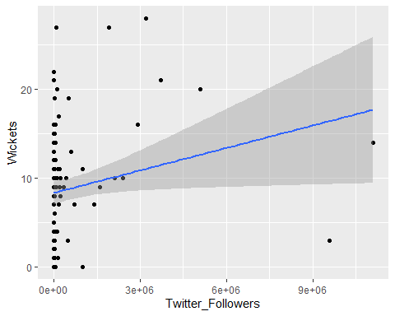
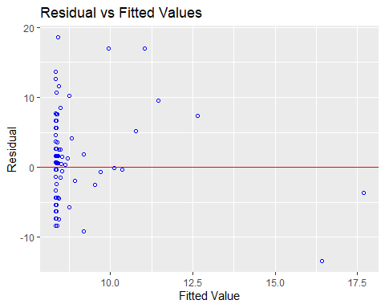
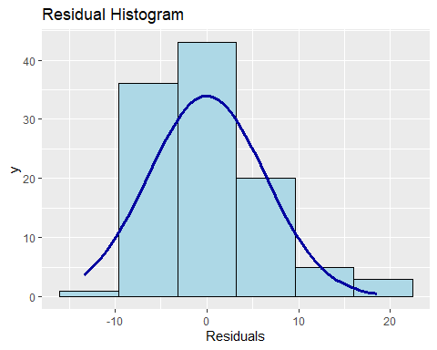
Twitter_FOLLOWERS AGAINST WICKETS
Twitter_Followers and Wickets have a weak linear relationship
Do not satisfy homoscedasticity
Residuals show a weak normal distribution
Therefore, they might be removed in the final models

Slide 12
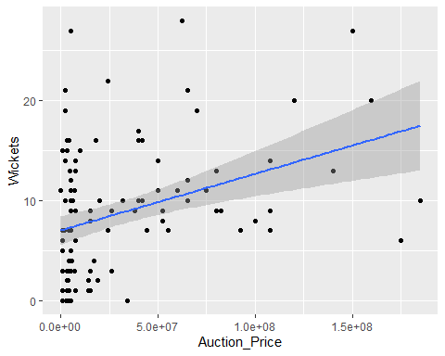
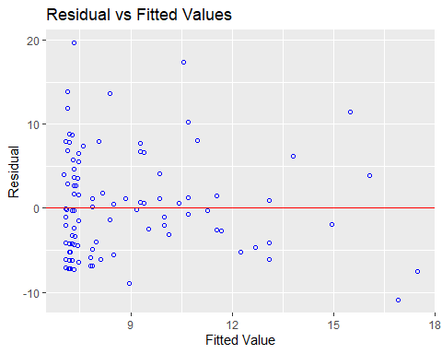
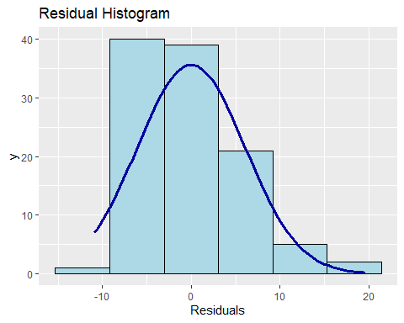
AUCTION_PRICE AGAINST WICKETS
Auction_Price and Wickets have a strong linear relationship
Obeys homoscedasticity
Shows normality of residuals

Slide 13
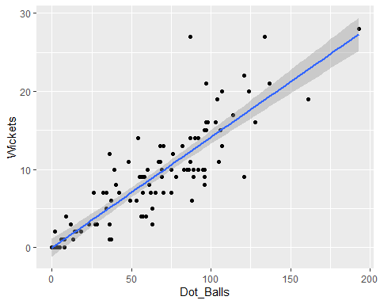
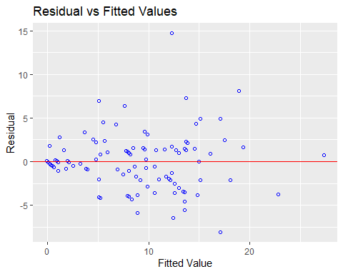
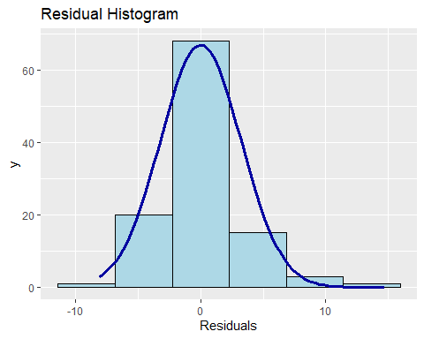
DOT_BALLS AGAINST WICKETS
Dot_Balls and Wickets have a strong linear relationship
Obeys homoscedasticity
Shows normality of residuals

Slide 14
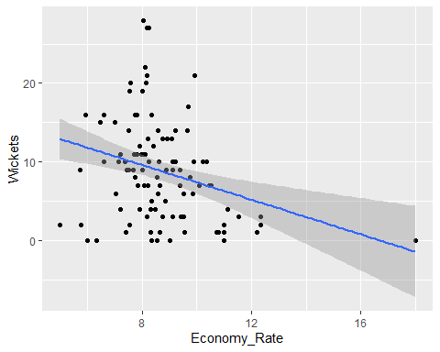
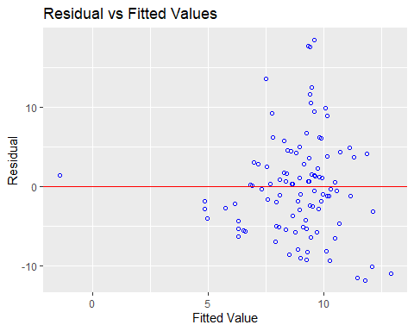
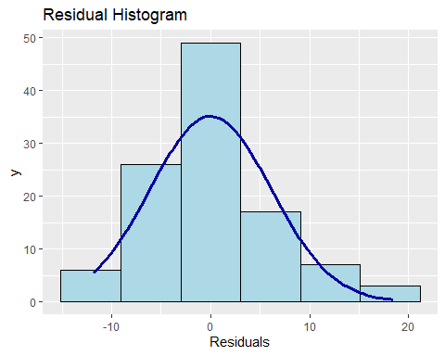
ECONOMY_RATE AGAINST WICKETS
Economy_Rate and Wickets have a weak linear relationship
Do not satisfy homoscedasticity
Residuals show a weak normal distribution
Therefore, they might be removed in the final models

Slide 15
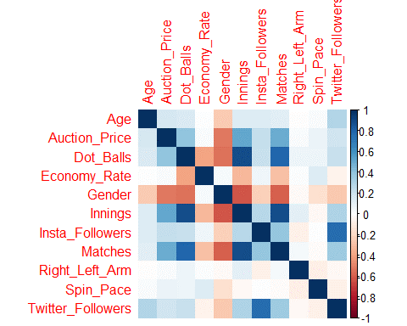
CORRELATION MATRIX –
INSIGHTS
Positive correlation observed between Dot_Balls and Wickets, indicating that bowlers with more dot balls tend to take more wickets.
Matches and Wickets show a decent positive correlation, suggesting that bowlers who play more matches have increased opportunities to take wickets.
Innings and Wickets display positive correlation.
Weak and negligible correlations between Instagram/Twitter followers and wickets suggest that social media presence has minimal influence on bowling performance.
A strong positive correlation between Instagram and Twitter followers indicates comparable follower growth rates across platforms.
Moderately strong positive correlation observed between Gender and Spin_Pace, highlighting that women players in the dataset are predominantly spinners, while men have a balanced mix of spinners and pacers.
Gender vs Dot_Balls and Auction_Price show medium strength correlations, suggesting that, on average, men bowled more dot balls and achieved higher auction prices compared to women players.

Slide 16

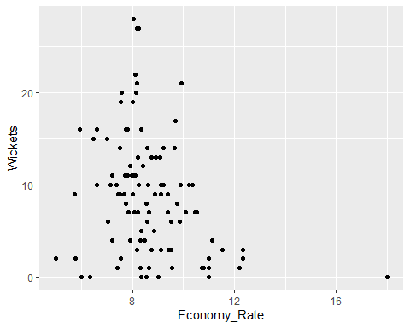
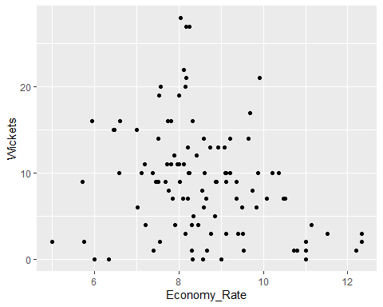
Outlier detection and removal
The above graphs show the data points of Economy_Rate before and after removing outliers.

Slide 17
Outlier detection and removal
Just like the example shown in the previous slide:
Our data set had three variables which has outliers in it.
We identified the outliers by plotting a scatter plot.
We removed them giving an acceptable range where every data point follows the assumptions of simple regression.
In total, we removed five observations from our data set to make our analysis much more accurate and efficient.
Removing outliers was the first step in our regression analysis project to prevent any ambiguous and spurious results.
The multiple R-squared value and adjusted R-squared value also became much better i.e., 85% which proves the importance of removing outliers.

Slide 18

Multiple linear regression
Through out the regression we made 8 models in total, trying out different permutations and combinations of variables to get the best fit.
We also included interaction terms with multiple combinations to know the multiplicative impact of interactions.
We also used forward selection and backward elimination to add and delete variables to get the best fitted model.
We also took log of certain variables to transform heavily skewed data to be more normally distributed.
Additionally, we did residual analysis as one the assumptions of simple linear regression.
For that, we performed ANOVA on all the formed models to get the RSS (Residual Sum of Squares) to find the best model.
We have considered the WicketsStep as our final model since it gave us the least RSS value of 605.30, which is the best of all the other models formed.

Slide 19
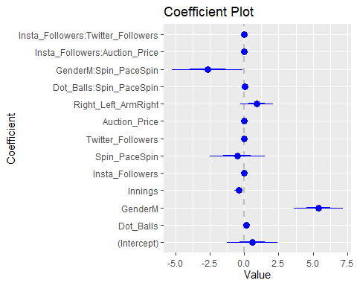
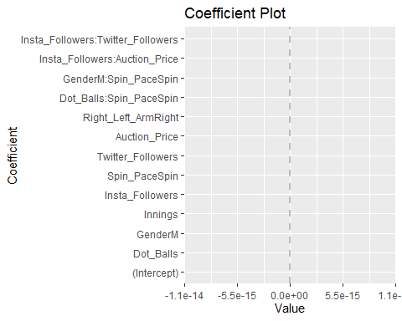
Final model
wickets= 1.714e+4.605e^-1matches-6.98e^1innings+ 5.72e genderM+ 1.604e^-1 dot_balls-2.88e^-8 auction price+9.51e^-1 spin_pace + 6.99e^-1 right_left_hand-3.458e^-2 gender*dot_balls + 1.03e^-14 insta_followers:auction_price
Coefficients: Estimate Std. Error t value Pr(>|t|) (Intercept) 5.868e-01 9.257e-01 0.634 0.52772 Dot_Balls 1.343e-01 1.616e-02 8.308 9.43e-13 *** GenderM 5.393e+00 8.869e-01 6.081 2.84e-08 *** Innings -4.136e-01 1.568e-01 -2.637 0.00984 ** Insta_Followers -3.801e-07 8.159e-07 -0.466 0.64244 Spin_PaceSpin -5.104e-01 1.002e+00 -0.509 0.61177 Twitter_Followers -1.895e-06 9.052e-07 -2.094 0.03912 * Auction_Price -2.878e-08 9.857e-09 -2.920 0.00442 ** Right_Left_ArmRight 9.166e-01 5.912e-01 1.550 0.12454 Dot_Balls:Spin_PaceSpin 4.621e-02 1.656e-02 2.791 0.00642 ** GenderM:Spin_PaceSpin -2.661e+00 1.284e+00 -2.073 0.04107 * Insta_Followers:Auction_Price 1.028e-14 4.914e-15 2.091 0.03932 * Insta_Followers:Twitter_Followers 3.378e-13 1.748e-13 1.932 0.05644 . --- Signif. codes: 0 '***' 0.001 '**' 0.01 '*' 0.05 '.' 0.1 ' ' 1 Residual standard error: 2.593 on 90 degrees of freedom Multiple R-squared: 0.8547, Adjusted R-squared: 0.8353 F-statistic: 44.11 on 12 and 90 DF, p-value: < 2.2e-16

Slide 20
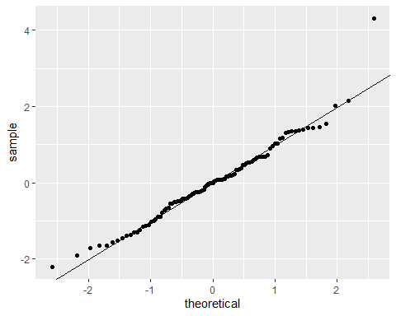
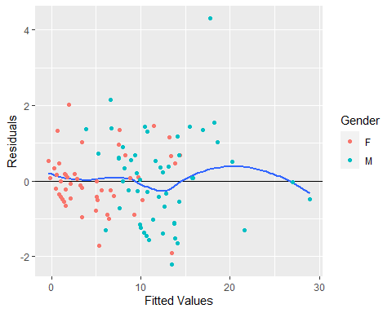
MODEL DIAGNOSTICS
Q-Q Plot
Residuals vs Fitted Values

Slide 21

Final Model - Insights
WicketsStep is selected as the final model since it has the least RSS value.
The model has an R-squared value of 0.8547 and adjusted R-squared of 0.8353. This means that the predictor variables included in the model explain around 85% of the variation in the number of wickets taken by bowlers.
The adjusted R-squared value is also very close to the R-squared value, indicating that model has not been overfitted by including extraneous variables.
The residual standard error is 2.593, which gives an estimate of the standard deviation of the residuals or prediction errors. This value is small relative to the scale of the response variable (Wickets), indicating decent predictive performance.
Most of the predictor variables included in the final WicketsStep model seem statistically significant based on the p-values.
Interaction effects between variables like Gender & Dot balls, Spin pace & Dot balls improve the predictive capability and are retained in the final model.

Slide 22

Conclusion
In summary, the high R-squared, low prediction error, significant variables and interactions make this a good fit model with good predictive performance as visible from the diagnostic plots as well. This model explains a large portion of variability in the wicket taking capability of bowlers based on important explanatory variables related to skill, experience, bowling style, no. of matches/innings played and the auction price/relevance of the individual players.

Slide 23

Future scope
To conduct linear regression analysis on bowlers’ performance in IPL/WPL 2023.
To ascertain the impact of variables like age, economy rate, bowling style, and number of overs bowled on the bowlers’ performance, measured by the total number of wickets taken.
To look into different transformations and interactions between different independent variables and come up with the best possible model.
To gain valuable insights that can be extracted from the identified correlations, offering a deeper understanding of the relationships and their implications.

